Slide 1
Online Bank Company – Sales Optimization
- By ‘The Good Karma’

Slide 2



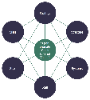
Agenda
Meet our Team
Problem Overview
Recommended Solution

Slide 3

Our Background
Graduate students at the M.S. Business Analytics
Leveraging our team’s experience across industries
Technology
Economics
Finance
Consulting
“Turning Analytics into Insights”

Slide 4




Online Bank Co. wants to prioritize and streamline salesperson activities
Problem Overview
Current Situation
Ideal Future State
Online Bank Co. is new in the market
They have obtained a huge list of merchant leads and have limited resources
A detailed call ensuring maximized operating efficiency while considering the ROI
Key Questions
Who are my high value targets?
How to prioritize these targets?
How to optimize the logistics to approach them?

Slide 5
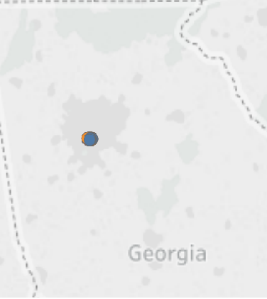
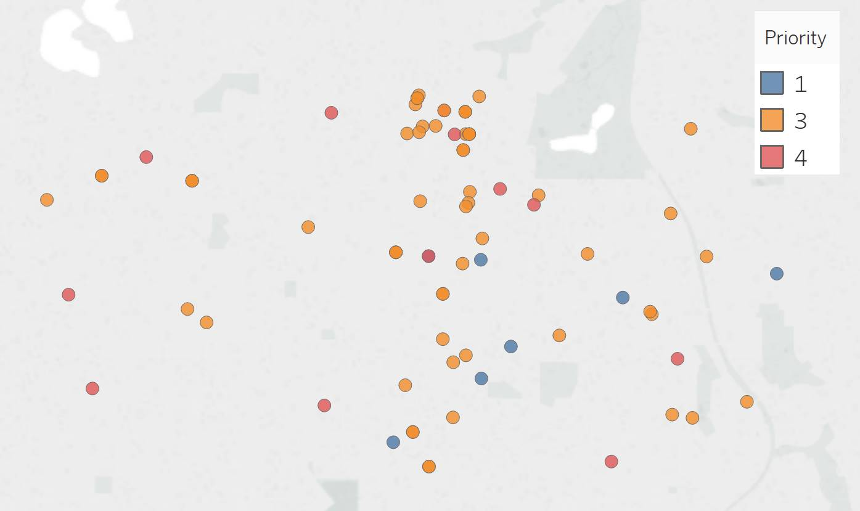
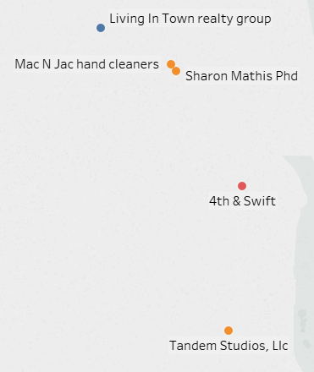
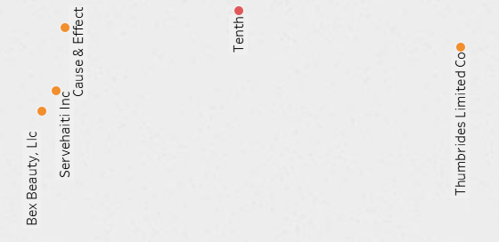
An example of route optimization for salespersons Johnathan Eisen & Laurin Wine
Problem Overview
Georgia
Atlanta sub area
Johnathan Eisen’s Route
Laurin Wine’s Route
Illustrative

Slide 6
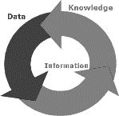

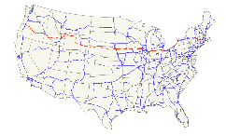
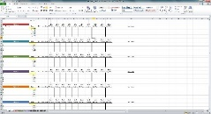
We can build a capability that enables Online Bank Co. to maximize their operational efficiency
Solution Overview
Outcome
Data Preparation
Priority Assignment
Route Optimization
Optimized Call Plan
Execution
Outcome:
Clean and relevant data required for further steps
Outcome:
Prioritized Merchant Leads
Outcome:
Optimized route to maximize coverage of relevant merchant leads
Outcome:
Detailed call plan at different levels ranging from the country up to sales person
Steps:
Merchant Leads data
Missing value treatment
Data exploration
Reshape data
Geographical data from API
Formatting data
Data exploration
Steps:
Feature selection
Clustering the merchant leads
Assigning priority to the leads based on cluster analysis
Steps:
Formulate penalty function based on distance and priority
Optimize the route for each salesperson based on the above penalty function
Steps:
Visualize the routes for each sales person
Aggregate to various levels such as city, state and country level for holistic management
Tools
/Algorithms
Exploratory Data Analysis
Data Wrangling
Feature Selection
k- means Clustering
Genetic Algorithms
Tableau
BI

Slide 7
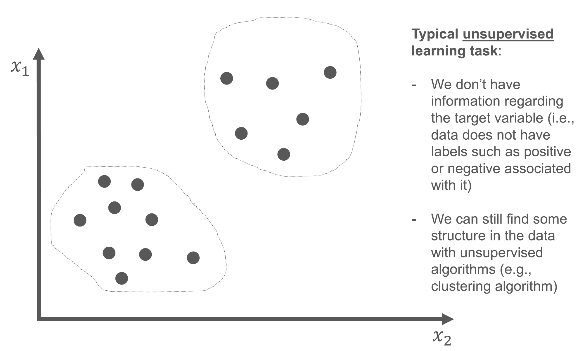
Using unsupervised learning algorithm and feature selection, we can find the right target leads
Priority Assignment
Data used
POI data for Atlanta and Athens
~ 70,000 leads
Feature selection
Total Sales Volume
Industry type
Agent Codes
Number of Employees
Number of subsidiaries
Algorithm
Unsupervised learning algorithm
Result: Identified 14 optimum, distinct clusters

Slide 8
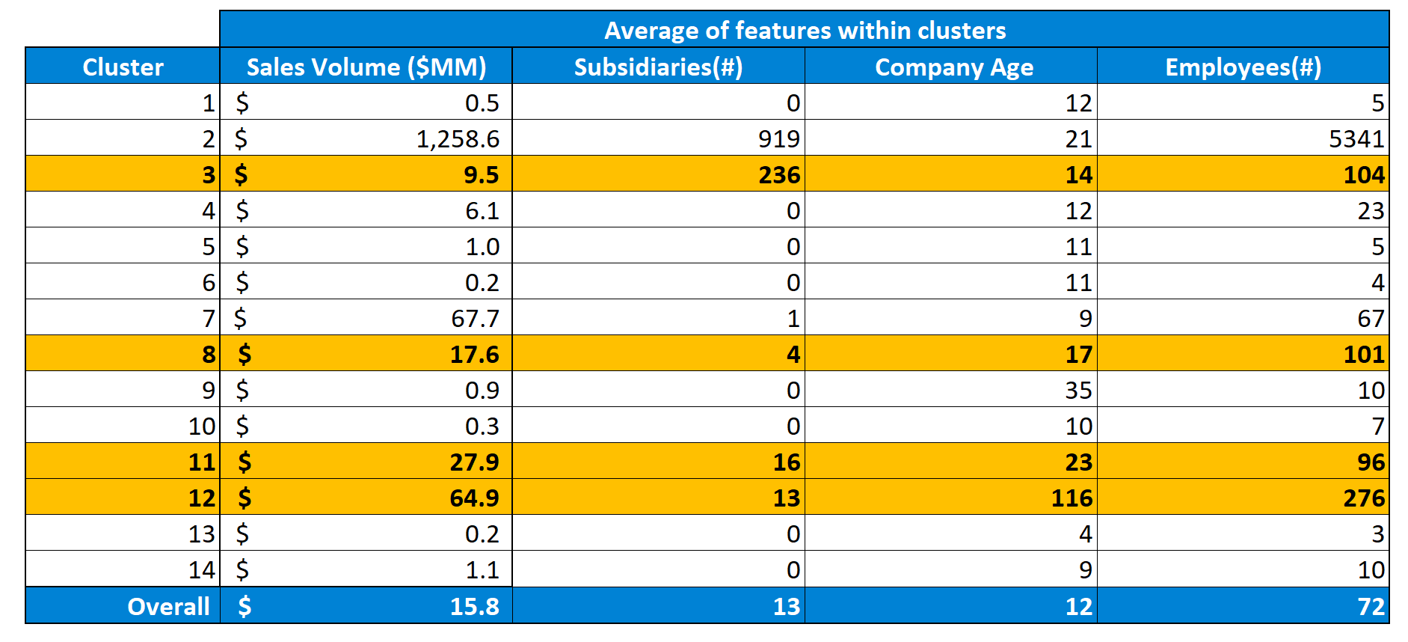
We chose 4 clusters from the 14, which were the closest representation of the ground reality for the pilot
Priority Assignment
All clusters are significantly different from one another
Clusters 3,8,11,12 were picked as they most closely represent the population and make the most business sense to target

Slide 9
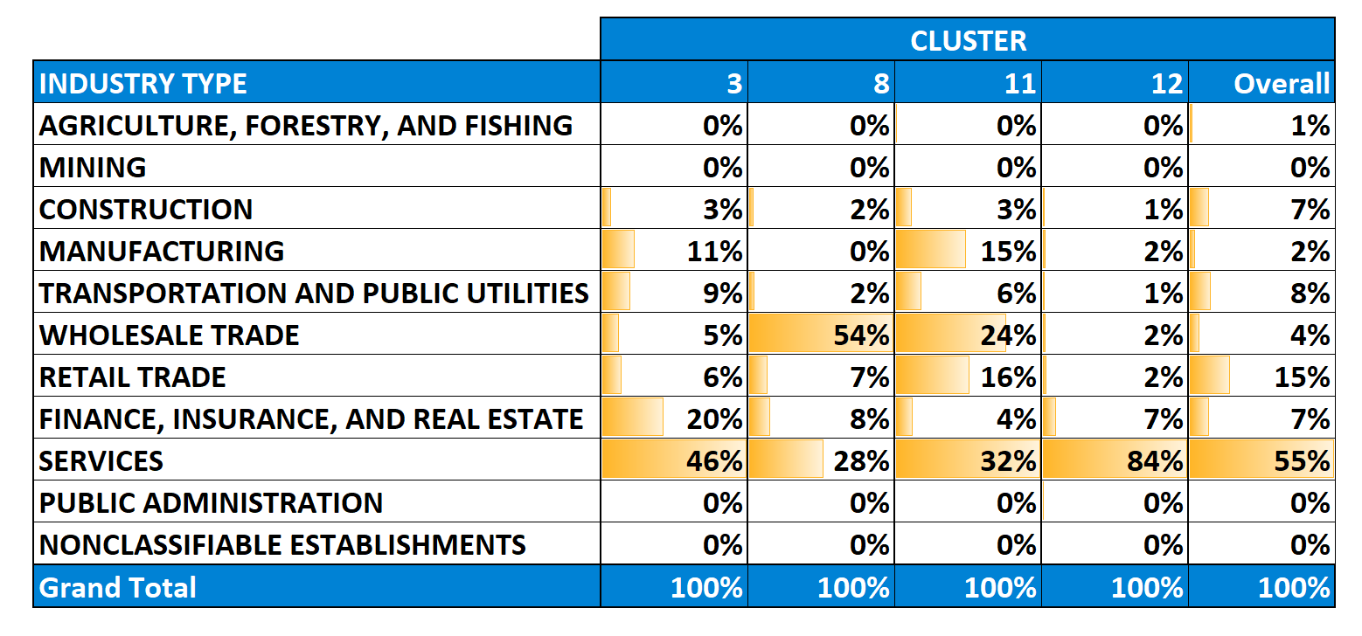
Clusters were inspected to make sure that they are not biased towards a single industry
Priority Assignment
Clusters 2,3,8,11,12 seem to be a close representation of reality as they are not biased towards just one industry. We need to ensure that these groups are significantly different from each other and if it makes business sense to target these groups

Slide 10
Assigning priority to clusters and assigning weights to them based on incremental cost/benefit
Priority Assignment
 | Weights added to distance
Priority | To
From | 1 | 2 | 3 | 4
1 | 1 | 1.57 | 1.73 | 1.85
2 | 0.64 | 1 | 1.10 | 1.18
3 | 0.58 | 0.91 | 1 | 1.07
4 | 0.54 | 0.85 | 0.93 | 1
Example
Companies : A B
Priority : 2 -> 1
Incremental benefit of targeting B vs A : 40%
Distance reduced : 100-40 = 60%

Slide 11
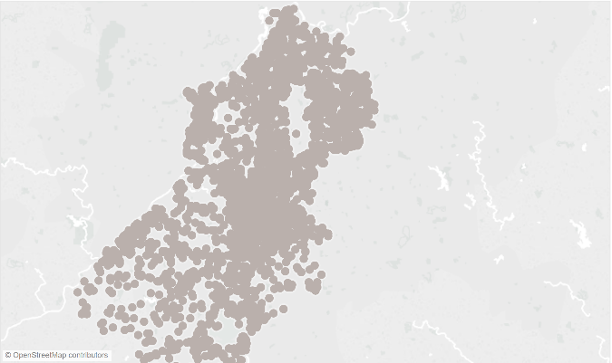
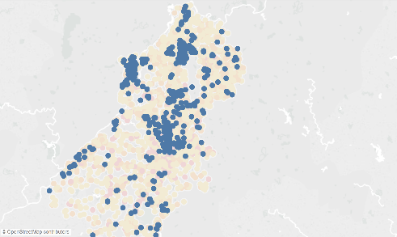
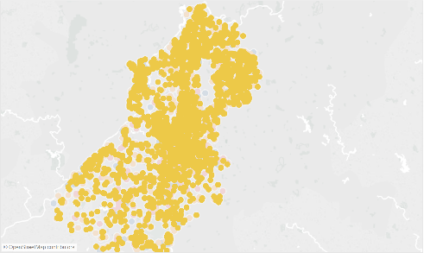
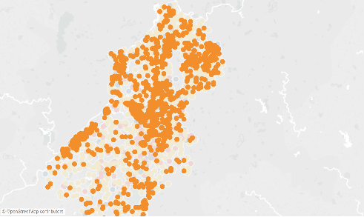
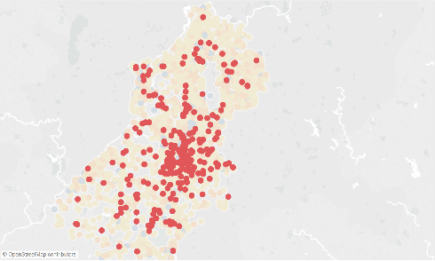
Visualizing benefit of prioritization of targets
Priority Assignment
Atlanta
Priority 1
Priority 2
Priority 3
Priority 4
No Priority

Slide 12

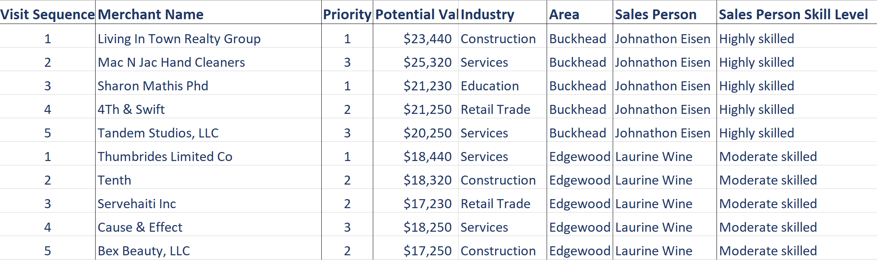
We can cover the target group of merchants by optimizing the routes
Route Optimization
Clustered Customer Leads
Sales-force Data
Optimized Call Plan
Algorithm
GeoRoute API
Penalty and Reward Function

Slide 13
An example of route optimization for salesperson Johnathan Eisen & Laurin Wine
Route Optimization
Georgia
Atlanta sub area
Johnathan Eisen’s Route
Laurin Wine’s Route
The algorithm finds path for all the salesmen. The solution of multiple salesman traveling problem is a difficult scheduling problem. Genetic algorithms or meta heuristic methods are employed to find the solution. We have created a sample solution for sales persons.

Slide 14
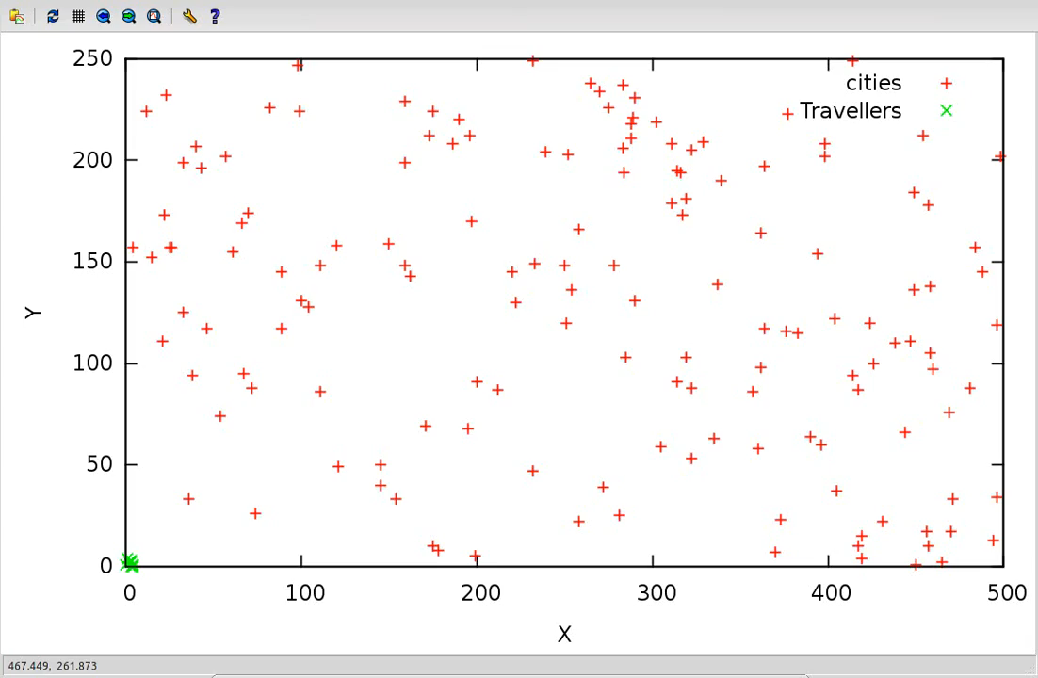
An improvement of our route optimization algorithm is to implement genetic algorithm
Route Optimization

Slide 15
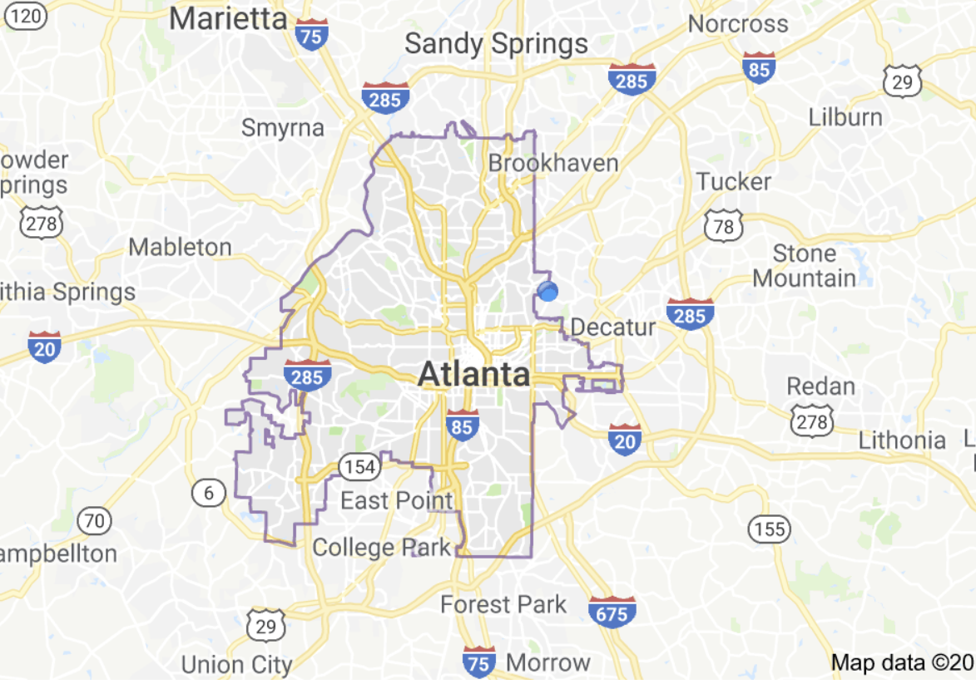




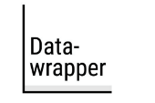

Deployment of this solution can be made relatively easy and scalable for a pilot
Solution Overview
Prioritized Target List
Routing Algorithm
Visualization Tool
Atlanta
Cluster 1
Cluster 2
Cluster 3
Cluster 4
Optimized Call Plan
Result

Slide 16






Several companies using route optimization have realized multiple benefits from increase in profit to reduction in operating costs
Solution Overview
Up to 25%
Reduction in non-realized sales
Up to 17%
Reduction in ground operating cost
Up to16%
Increase in profit

Slide 17






Thank you
Aman Jiddewar
Pooja Adiseshu
Prajwal Kuchangi
Khasim Sheik
Abhishek Saha
Haoyang (Luis) Sang

Slide 18
Appendix

Slide 19
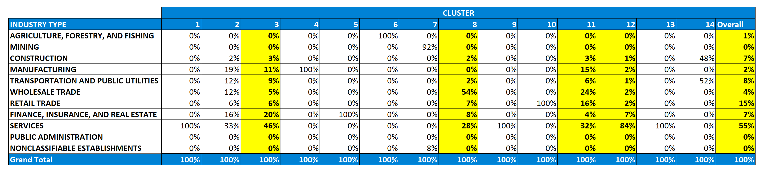
We chose clusters which were the closest representation of the ground reality for the pilot
Clusters 2,3,8,11,12 seem to be a close representation of reality as they are not biased towards just one industry. We need to ensure that these groups are significantly different from each other and if it makes business sense to target these groups

Slide 20
References
McKinsey route optimization
FedEx Ground route optimization

